Slide 1





The Water-Energy-Food Nexus (WEF)
Stakeholder Information and Engagement Workshop
Registration
9:30 -10:00 AM
San Antonio, TX| January 10, 2018

Slide 2
Master of Ceremonies
Rudy Rosen, Director
Institute for Water Resources Science and Technology
Texas A&M University, San Antonio
10:00 – 10:05 AM
San Antonio, TX| January 10, 2018

Slide 3
Welcome Note
Dr. Cynthia Teniente-Matson
President, Texas A&M University–San Antonio
San Antonio, TX| January 10, 2018

Slide 4
Overview:
Texas A&M Water-Energy-Food Nexus Initiative (WEFNI)
Workshop Objectives
Rabi H. Mohtar, TEES Research Professor
Coordinator, WEF Nexus Initiative, Texas A&M University
Faculty of Agriculture and Food Sciences, American University of Beirut
10:05-10:15 AM
San Antonio, TX| January 10, 2018

Slide 5

WEFNI – GOALS
Expand intellectual capacity and scope of TAMU’s Water-Energy-Food Nexus Community by developing analytics, policy, and governance best practices;
Establish a Nexus Community of Science;
Identify opportunities and gaps in current WEF Nexus related research.
Launched in 2015
200 research and extension faculty from Texas A&M System
WEFNI supports 6 PhD and 8 MSc students from Geosciences, Geography, WMHS, BAEN, Mechanical, and Chemical Engr.
2 Special Issues
18 INFEWS proposals submitted
National and Global Partnerships

Slide 6
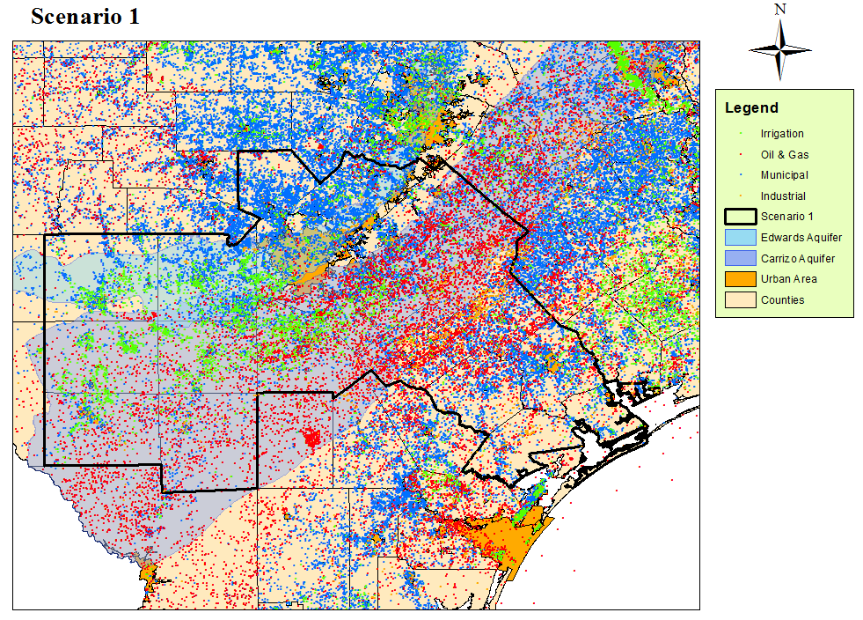
The San Antonio Hotspot
Daher et al.

Slide 7
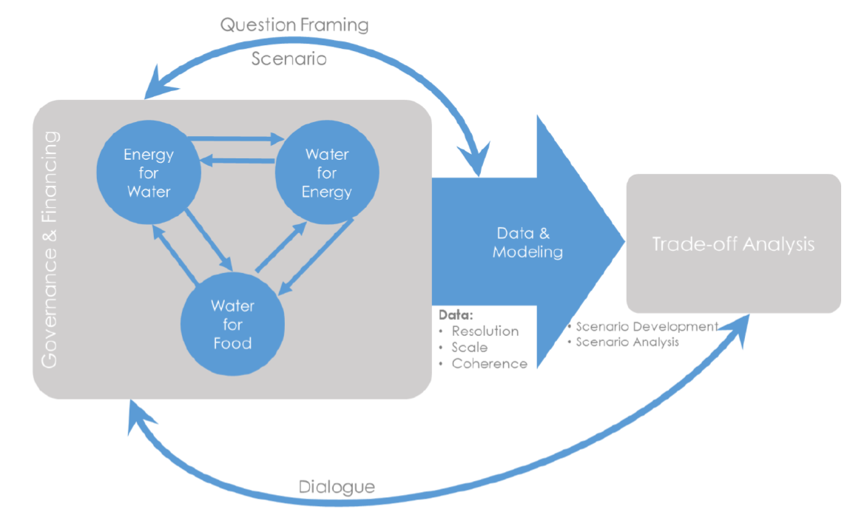
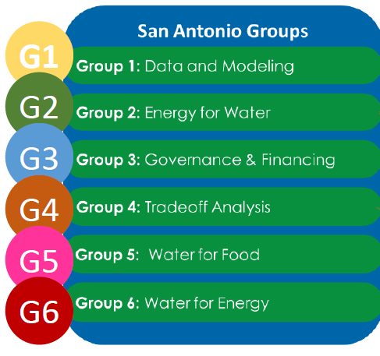
The San Antonio Case Studies

Slide 8
Texas Water Gap
Lubbock:
Encourage dry land agriculture
Increase reliance on reclaimed waste water for agriculture
Invest in renewable energy
Financial investment required
Potential of bridging 3 billion gallons Potential cost: 121 Million Dollars
San Antonio Region:
Implementing LIDs would elevate some of the stresses on water for agriculture
Potential of additional 47 billion gallons to the agricultural water supply in the San Antonio region every year.
The financial cost could be as
large as 4 Billion Dollars
- Potential for urban agriculture
How can we
bridge the
Texas water gap
(8.9 Billion cubic meters in 2070),
given projected
population growth &
climate change stresses,
while accounting for
variable water availability
water demanding sectors
across different regions of the state?
Eagle Ford Shale:
The shale development in Eagle Ford increases the groundwater consumption in South Texas
The future net benefits of hydraulic fracturing industry are huge for counties and Texas, but the amount of benefit will change if we put more value on other natural resources such as water.
(Daher et. al, 2017 )

Slide 9
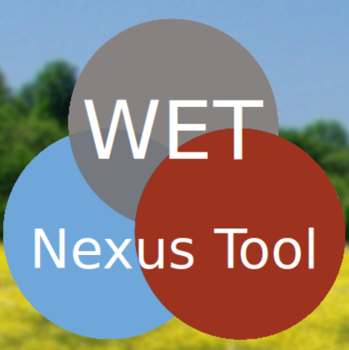
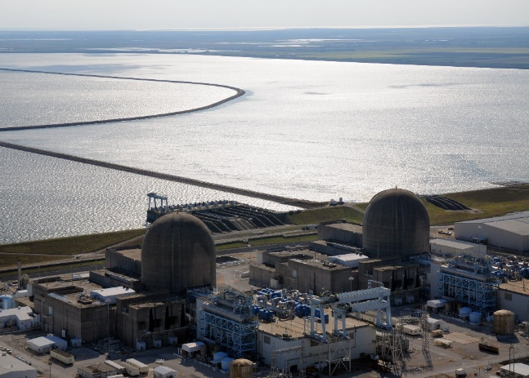
WEF Nexus SAMPLE PROJECT OUTCOMES
WET Tool
Quantify the interrelations and trade-offs between the water, energy, and transportation sectors under different scenarios:
Increasing (or decreasing) production
Changes in oil and gas market price
Different lateral lengths
Amount of reused water
Varying modes of transport for water/oil/gas
Matagorda County, Texas
Annual income could increases by as much as $32 million over the current “business as usual” mainly addressing the agricultural sector, which currently suffering from lack of water.
Energy Portfolio Assessment Tool (EPAT)
EPAT shows that the CPP policy succeeds in mitigating the carbon emissions by sustaining same level even after capacity increase, and in decreasing the water withdrawal volumes in generation by 35%. On the other hand, the CPP policy increases water consumption by 5%, land use by 143% and cost by 18%.

Slide 10


Special Issue
Paper #1: Are Current Allocation Models Capable of Addressing Increasingly Interconnected and Complex Resource Hotspots?
Paper #2: WEF Nexus Modeling and Climate Change Impact
Paper #3: Water, Energy, and Food Waste Reutilization in San Antonio
Paper #4: Environmental Impact Assessments of San Antonio’s Water Expansion Projects Using Life Cycle Analysis
Paper #5: Energy Portfolio Assessment Tool (EPAT): Sustainable Energy Planning Using the WEF Nexus Approach – Texas Case
Paper #6: Development and Application of an Urban Water, Energy, Food Nexus Analytic Tool
Paper #7: WEF Nexus Governance Cooperation in San Antonio
Paper #8: Impact of Secondary Treated Municipal Wastewater Irrigation on Soil Chemistry and Clay Mineralogy
Paper #9: Effect of treated municipal treated wastewater on the hydro-structural properties of a clayey, calcareous soil
Paper #10: Developing a Farm-scale Food-Water-Energy-Soil-Waste Nexus Framework for the Closed-Loop Dairy Concept
Paper #11: Impact of Manure Derived Biochar as a Soil Amendment: Water-Soil-Waste Nexus Study at a Texas Dairy
Paper #12: Hydraulic Fracturing – a WEF Socio-Economic Assessment Tool
Paper #13: Photo Catalysts for Water Treatment Using Solar Energy
Paper #14: Optimal Water Allocation Planning using a Water-Energy-Food Nexus Approach: The Case of Matagorda County, TX
Paper #15: Towards bridging the water gap in Texas: A Water-Energy-Food Nexus Approach
Paper #16: Water-Energy-Food Nexus Review Paper
Timeline
Prelim drafts
Final drafts

Slide 11
Workshop Objectives
Inform stakeholders about ongoing and planned Nexus research and educational activities.
Identify possible and desirable information sharing opportunities and actions.
Identify and “test” the concept of coordinated stakeholder engagement for future Nexus-related matters.
Establish an ongoing dialogue between scientists, Nexus-related policy makers, government officials, civil society advocates, and industry leaders.
San Antonio, TX| January 10, 2018

Slide 12
Workshop Expected Outcomes
Identify barriers to improved communication between interrelated disciplines and sectors
Identify questions that the scientific community should be working on
San Antonio, TX| January 10, 2018
Notes:
a. Improved Communication: identify barriers between the interconnected disciplines and sectors
b. Improved Cooperation: identify questions of mutual importance to the scientific community and the stakeholder community

Slide 13
Science Panel
David D. Baltensperger , Moderator
Professor and Head of the Soil and Crop Sciences Department, TAMU
1. Key findings in sub-group
2. What are key challenges you face in conducting FEW nexus research?
3. What are your needs from governmental and industry/business institutions?
4. What do you have to offer governmental and industry/business institutions?
10:15-11:30 AM
San Antonio, TX| January 10, 2018

Slide 14
Science Panel
Kent Portney
Professor and Director of the Institute for Science, Technology and Public Policy
Bruce Mc Carl
Texas AgriLife Senior Fellow, Regents Professor & Distinguished Professor of Agricultural Economics
Valentini Pappa
Adjunct Professor, Biological and Agricultural Engineering
Debalina Sengupta
Associate Director of the Gas and Fuels Research Center for Texas A&M Engineering Experiment Station (TEES)
San Antonio, TX| January 10, 2018

Slide 15
Governance Group
1. Key findings in sub-group
2. What are key challenges you face in conducting FEW nexus research?
3. What are your needs from governmental and industry/business institutions?
4. What do you have to offer governmental and industry/business institutions?
San Antonio, TX| January 10, 2018

Slide 16
Key findings
Modest amount of communication within the water domain
Very little communication between water, energy, and food/agriculture domains

Slide 17
Key challenges
Engaging a full range of stakeholders and policy makers
Tapping extensive on-the-ground knowledge, experience, and expertise
Framing answerable questions to promote improved nexus decision making
Generating relevant, usable, and actionable data

Slide 18
What do we need from San Antonio Institutions?
Partnerships and collaborators
Substantive guidance for analysis of decision making

Slide 19
What do we have to offer San Antonio Institutions?
Cross-sector experiences, knowledge, and opportunities
Points of potential intervention and cooperation

Slide 20
Modeling Group
San Antonio, TX| January 10, 2018

Slide 21
Team Objectives and Activities
Decision support via Evaluation and optimization of WEF alternatives
Evaluation of multidimensional implications
Suggestion of portfolios of approaches through optimization
Examination of needed compensation to make this work
Water Centered
Modeling that integrates agriculture, municipal, industrial, energy and environment
Model is just coming to life
Engaged in addition of alternatives

Slide 22
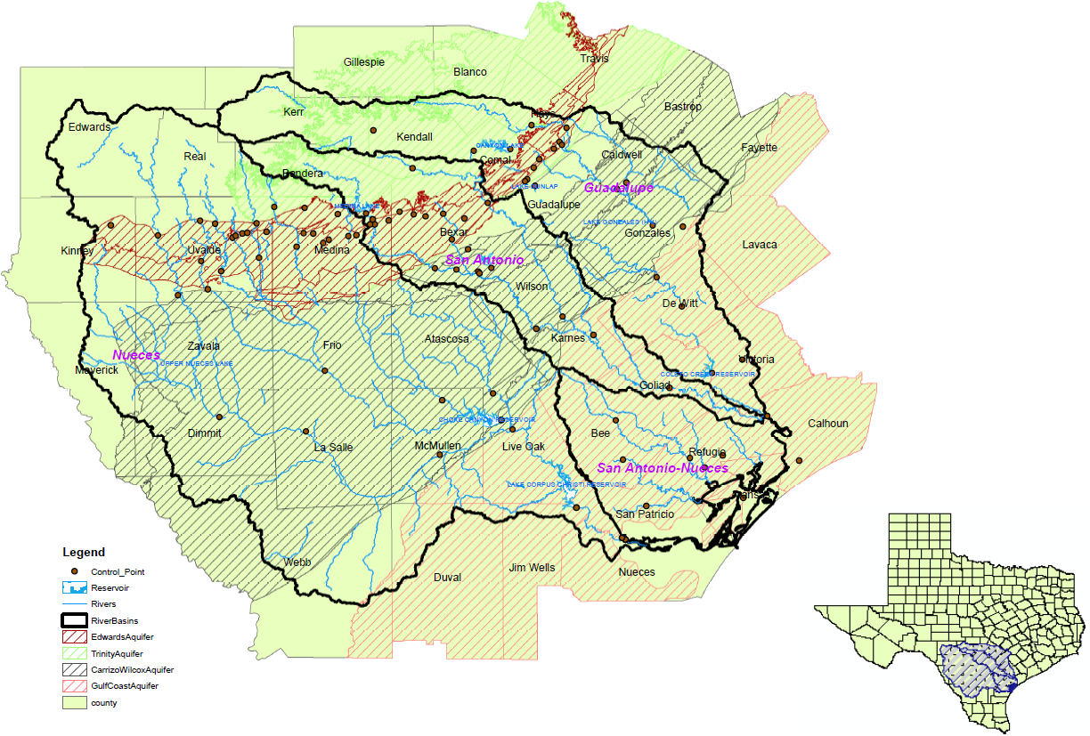
Key Activities – Geographic & Hydrologic Scope

Slide 23
Key Activities – Model Scope
Water Rights, & Markets
Reuse
Aquifers
(Edwards, Carrizo-Wilcox, Gulf Coast, Trinity)
Water Project Use (Exist and New)
Treatment Plants
Investments
State of Nature
New Water Projects (Y/N)
Modeled Water Demand
Rivers (Nueces, Guadalupe, San Antonio)
Aquifer Diverters
River Diverters
Hydrological Processes
Energy Retrofits
(Y/N)
Reservoirs (Canyon , ChokeCanyon, ColetoCreek, Lake Corpus Christi, Medina Lake, Lake Texana)
Aquifer recharge, Depletion, Elevation
River Flows
Return Flows
Evaporation

Slide 24
Key Activities – Model Scope
Modeled Water Demand
Brackish Water
Municipal Water
Water Projects (Exist & New)
Reuse
Industrial Water Use
Treatment Plants
Treatment Plants
Aquifer Diversion
Electrical Cooling Water
River Diversion
Agricultural Water Use
Cropland
Return Flows
Fresh water
Crop Production
Fracking Water Use
Pasture&
Range
Livestock Production
Water Recreation
Hydro-Electric

Slide 25
Prior Findings
Versions of model have been around for many years – first study 1990
400 k pumping limit expensive – springflow /elevation based better for both habitat and regional economy
Importance of El Nino state knowledge
Water projections high given price response
Water development projects not enough for 2050 if climate continues to evolve

Slide 26
Key challenges
  Data
  Identification of major WEF alternatives
  Mechanisms for implementation and compensation
  Conjunctive water use modeling
  Adding in environmental concerns (instream flows, bay and estuary, springflow)

Slide 27
WEF Alternatives – a starting point
Ag Irrigation methods and practices Alternative crops
Land to dryland or grazing Removing minimum limits
Degraded water use Crop mix
Water Use of more distant aquifers Injection &recovery
Reservoirs Saline sources
Enhanced recharge Conservation
Reuse
Energy Alternative cooling Coal to Natural Gas
Renewable sources wind solar Import more
Fracking water reuse Fracking technology

Slide 28
What help do we need from Regional Stakeholders?
Data and insights
  Identification of water conserving approaches and their costs
  Agricultural data on
  Effects of alternative irrigation possibilities
  Saline water use effects
  Effects on water project yields of drought
  Identification of possible policy changes (1 ac ft in ag?)

Slide 29
What do we intend to have to offer Regional Stakeholders?
Support for decisions
Multi dimensional Evaluations
Portfolios
Projections of effects of changes in population, water supplies, aquifer depletion, policies, projects, retrofits, alternative energy

Slide 30
Water-Food Group
1. Key findings in sub-group
2. What are key challenges you face in conducting FEW nexus research?
3. What are your needs from governmental and industry/business institutions?
4. What do you have to offer governmental and industry/business institutions?
San Antonio, TX| January 10, 2018

Slide 31
Key Objectives
Build a nexus-based model for tradeoff analysis and resource allocation for management of livestock production at a farm scale (1)
Evaluate the benefits of the closed-loop dairy concept for agricultural yield, environmental quality, and cost of inputs, including water and energy resources (1)
Quantify the impacts of dairy farm waste management practices, such as manure application and wastewater irrigation, by determining soil physical properties such as water retention and available water (2)
Study the changes in hydro-structural soil properties after long term waste application and their correlations with crop yield (2)
Recommend biochar systems for individual applications (3)

Slide 32
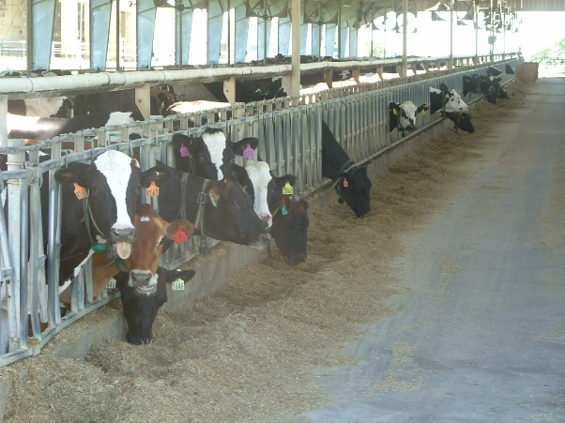
Key findings
….on going research
Multiway approach identifying energy, water, waste and food centric scenarios (1)
In depth understanding about the effects of waste application on physical soil properties which will allow for making informed waste management and irrigation decisions (2)
With optimization of variables contributing in biochar production, soil physical properties improvement would be maximized (3)

Slide 33
Long-term Impact of Wastewater Reuse on Soil-Water Holding Properties
More than 10 years of WWT reuse in a cotton field in San Angelo, TX.
The famer reported an increase in the cotton yield with wastewater reuse.
Trade-off between quality, cost, and soil health and productivity
Notes:
Terms: FC: field capacity: the maximum upper limit of the water content that the soil can hold after drainage due to gravity. PWP: is the water content at which the plant can no longer be able to take water out of the soil. The Available Water is the difference between them: AW = FC-PWP.
And of course, Wsat is the water content at saturation.
The message here is a nexus.
The rainfed fields produced the least amount of cotton, however, it seems that the rainfed fields are the healthiest as they have the highest available water content. Of course the reason for the low productivity is that the rainfed is not enough and irrigation is needed.
In this sense, WWT (irrigation with Treated wastewater) has a lower available water but it has the highest productivity of cotton. So the trade-off is between productivity, cost of treated wastewater, and soil and human health. It seems so far (10 years of irrigation).
So, actually. The groundwater is brackish TDS = 3000 – 40000 mg/l and therefore, compared to WWT, the reported yield was lower and as shown in the figure the available water is lower also.

Slide 34
Key challenges
Providing those interested decision-makers with clear, simple, yet comprehensive answers (1)
Combine energy-water-food data to establish a monetary value for several sectors (1)
In depth understanding about the effects of waste application on physical soil properties which will allow for making informed waste management and irrigation decisions (2)
Biochar characteristics and effects- multi parameters (3)
The availability and compatibility of data sets (1,2,3)

Slide 35
What help do we need from Regional Stakeholders?
Additional farm to contrast data
Any additional set of data?

Slide 36
What do we intend to have to offer Regional Stakeholders?
Offer a work in progress model of a dairy farm including manure management and biomass processing (1)
In depth understanding about the effects of waste application on physical soil properties which will allow for making informed waste management and irrigation decisions (2)
A guideline for specification of biochar based on soil type and structure (3)

Slide 37
Water-Energy
1. Key findings in sub-group 2 Energy for Water
2. What are key challenges you face in conducting FEW nexus research?
3. What are your needs from governmental and industry/business institutions?
4. What do you have to offer governmental and industry/business institutions?
San Antonio, TX| January 10, 2018

Slide 38
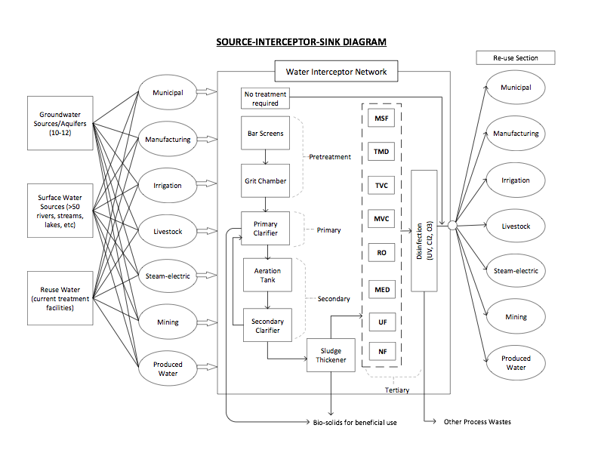
Key findings

Slide 39
Key findings

Slide 40
Key findings
General Framework completed for water network through a source-interceptor-sink model
Data Collection completed for generic water characteristics, water qualities for wastewater, and treatment methods
Detailed Cost Data compiled and cost curves constructed for various treatment strategies
Flowchart created for the optimization based decision making framework

Slide 41
Ying Li, Associate Professor
Pioneer Natural Resources Faculty Fellow
Advanced materials and solar energy enabled wastewater treatment and clean water production
Photocatalyst
Nanofibers
Nanocomposite
Coating
Membrane
Solar Energy
Solar thermal
Solar PV
Solar chemical
Hybrid solar
Advanced Materials
Water Treatment
Organic pollutant removal
Heavy metal removal
Disinfection
Desalination
Oil/gas produced water
Municipal/industrial wastewater
Seawater
Inland brakish water

Slide 42
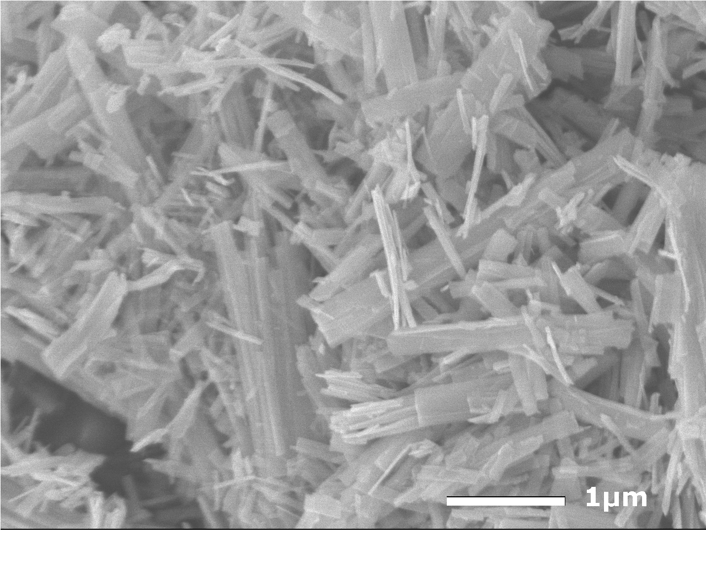
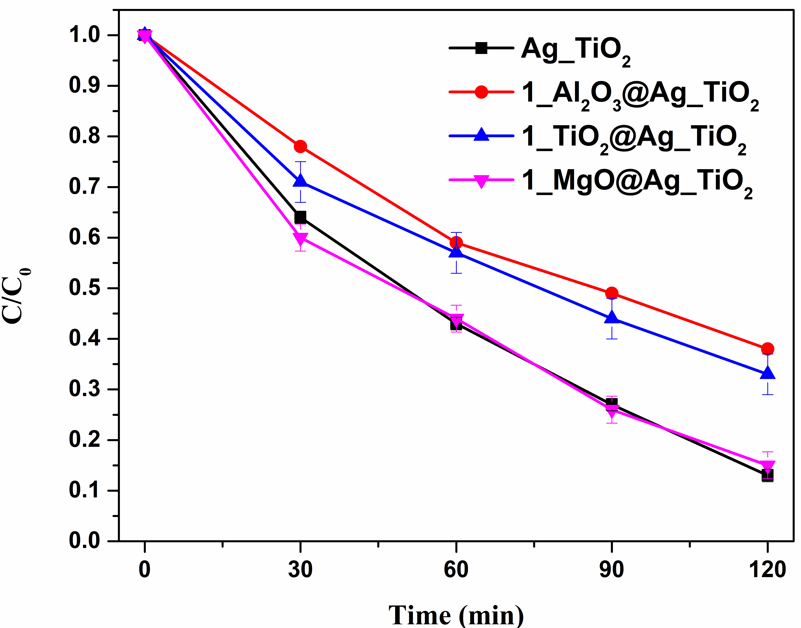
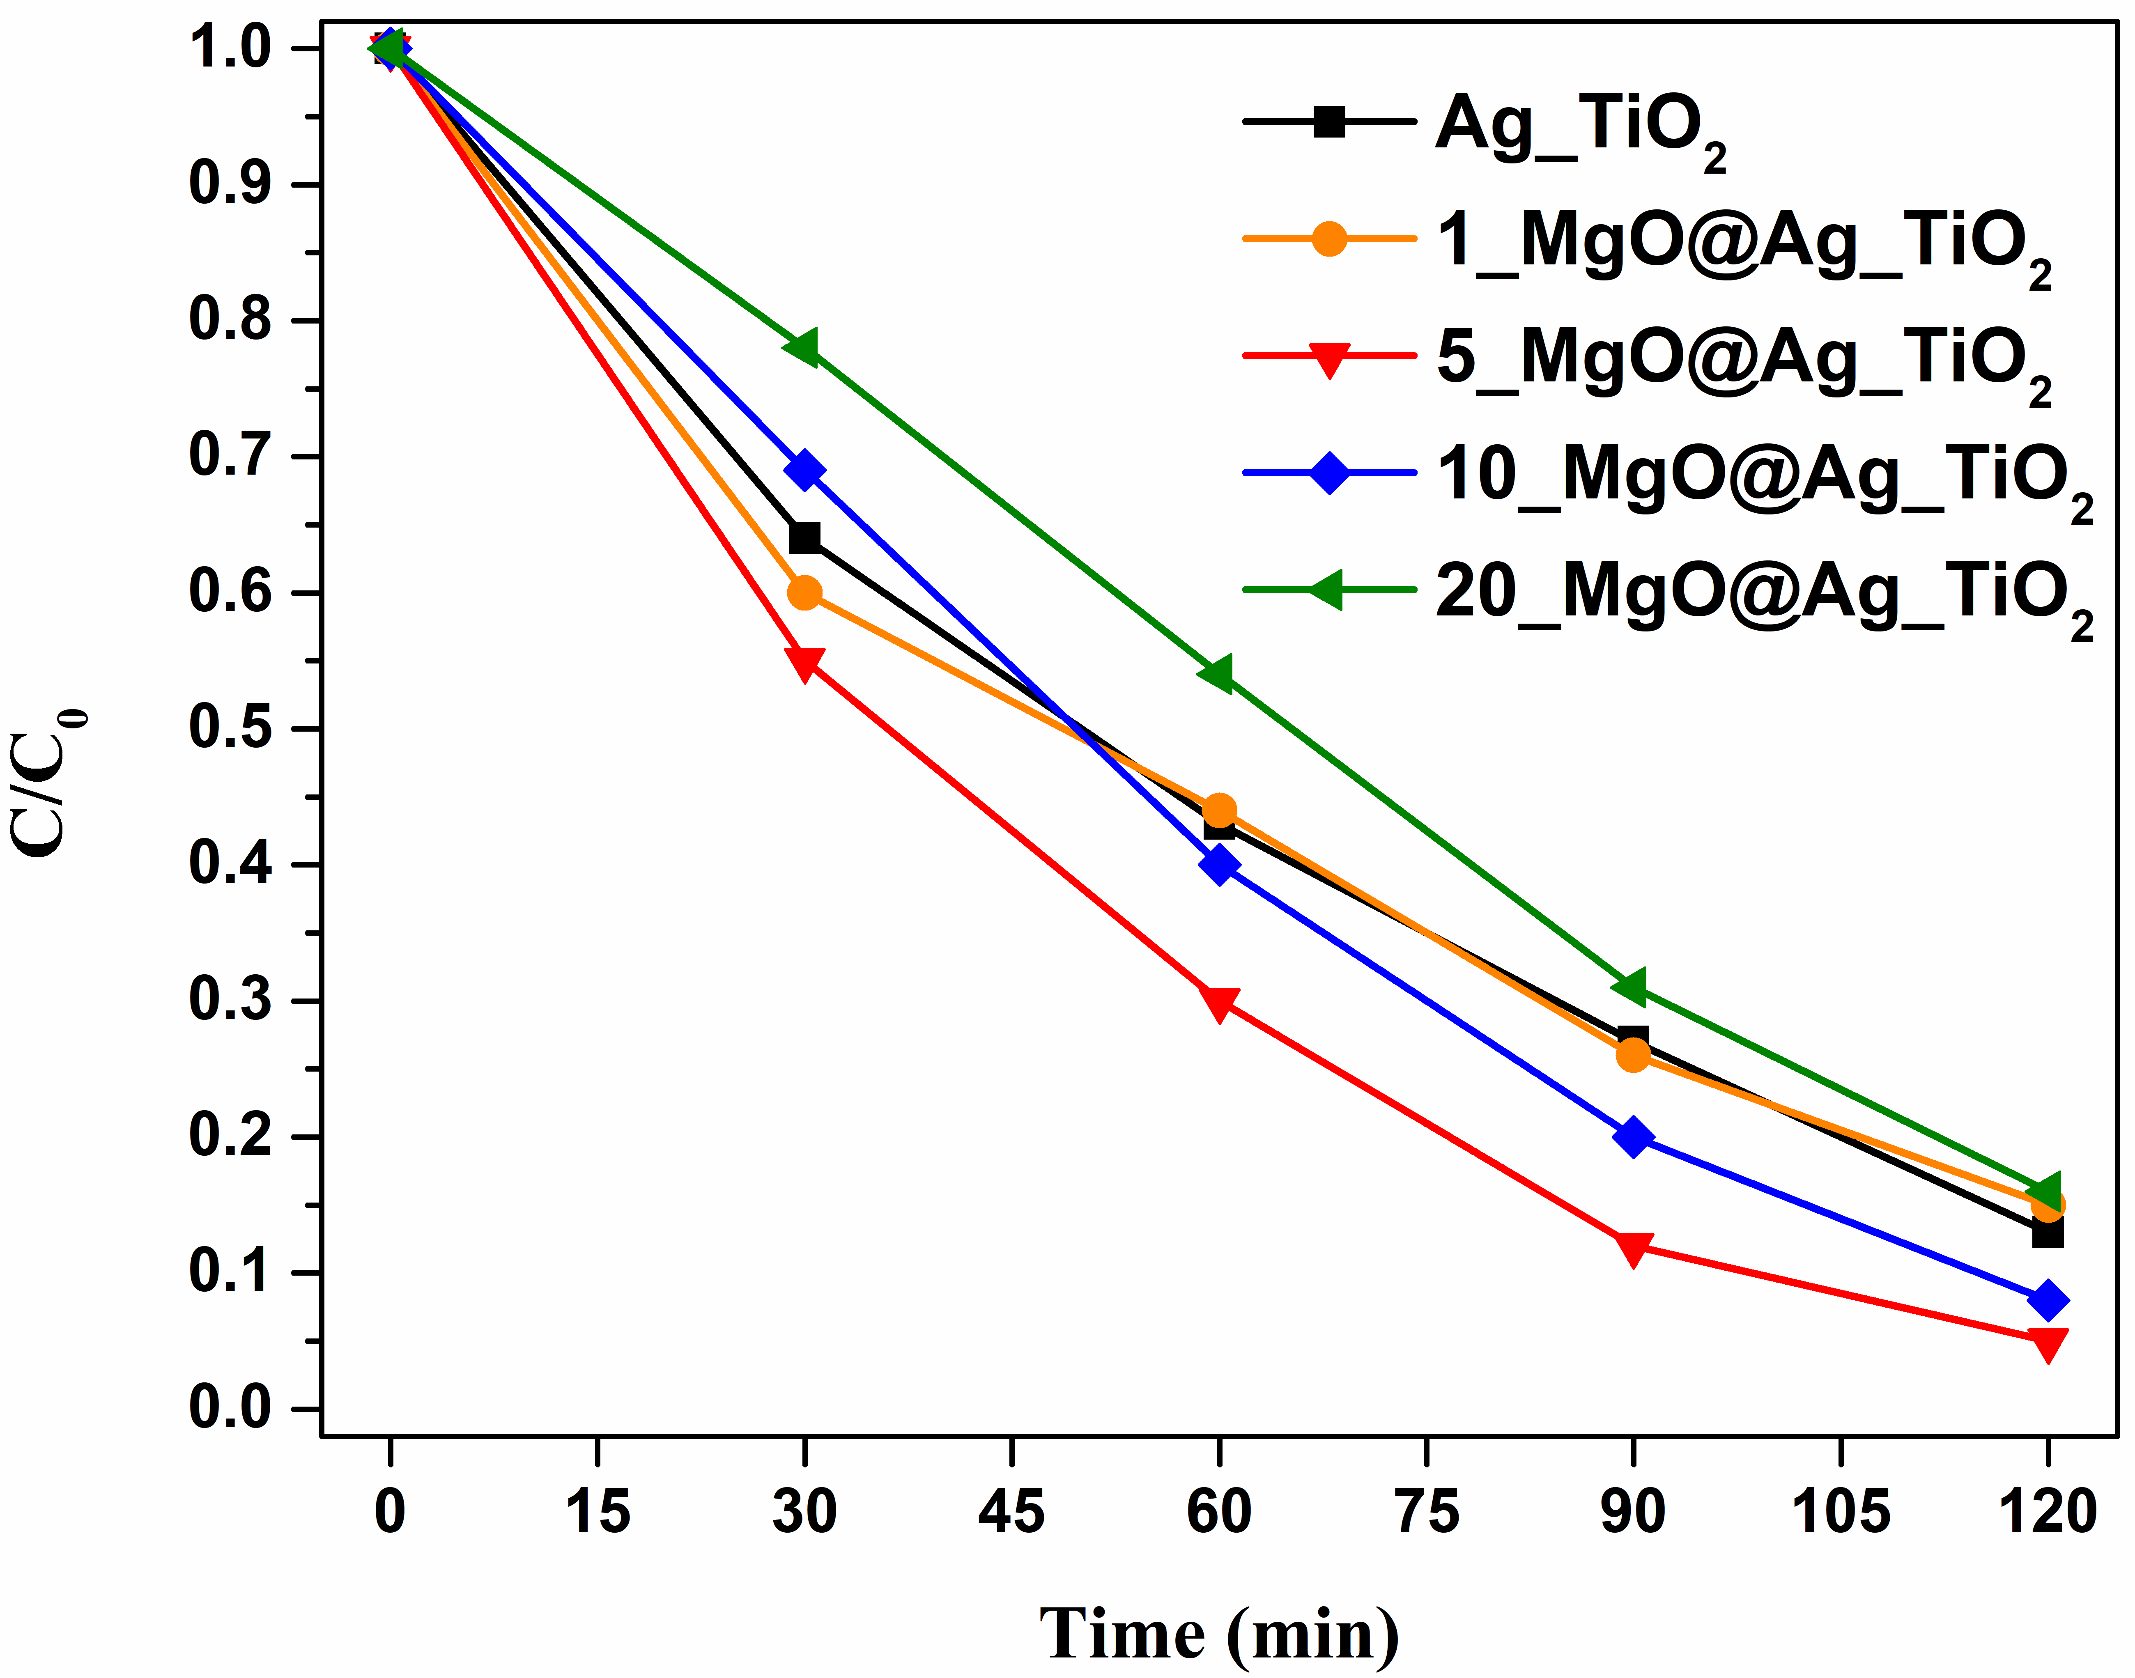
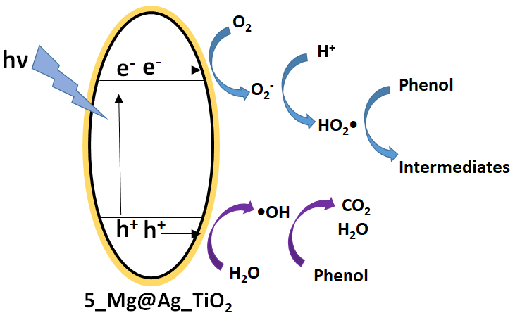
Atomic layer deposition (ALD) modified Ag_TiO₂ photocatalyst for phenol degradation under sunlight
Scott et al. submitted to Science of the Total Environment
Nanorod structured TiO₂
Ag modification
Best
Ag_TiO₂
ALD coating
Selection of ALD coating materials
Best
Sub-nanometer MgO coating enhanced phenol degradation efficiency and stability
Optimization of MgO layer thickness

Slide 43
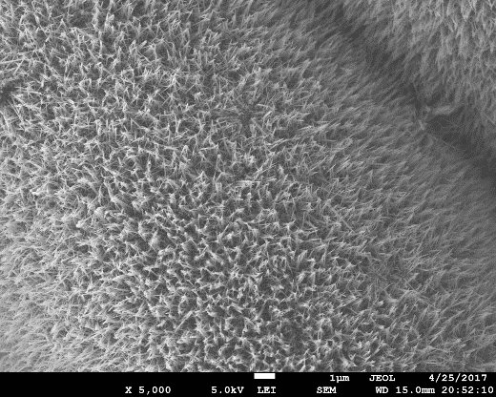
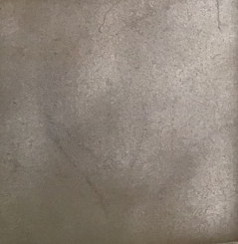
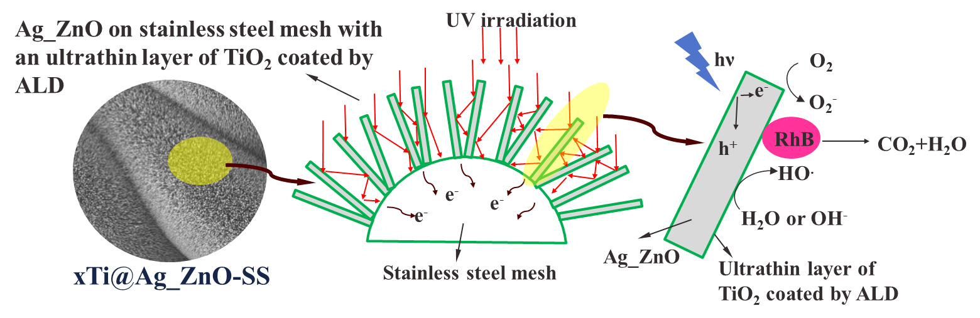
ALD layer protected Ag_ZnO nanorods grown on stainless steel mesh for organic dye degradation
Zhao et al. Advanced Composites & Hybrid Materials. In press
ALD is applied to coat protective TiO₂ layer on Ag_ZnO nanorods
Long term stability test
(10 cycles RhB degradation)
ZnO
Ag_ZnO
TiO₂@Ag_ZnO
5Ti@Ag_ZnO-SS
Metal modification
1 µm

Slide 44
Key challenges
Data validation challenges
San Antonio Case Study Data is required for specific information for the framework
Model is large, needs to be reduced for solution strategies
Acceptability of solutions offered, identifying stakeholders

Slide 45
What help do we need from Regional Stakeholders?
Specific Data for the San Antonio Region (Some of it is publicly available)
Engagement of municipal works in the model and results validation

Slide 46
What do we intend to have to offer Regional Stakeholders?
Detailed model of energy and material use for purifying water systems
Models for setting targets for purification
Challenge identification and providing solutions through data and model based approaches
Ability to analyze widely collected data on wastewater sources and providing mass, energy, and property integration strategies

Slide 47
Science Panel – Q&A
David D. Baltensperger , Moderator
Kent Portney
Bruce Mc Carl
Valentini Pappa
Debalina Sengupta
11:30 -12:00 AM
San Antonio, TX| January 10, 2018

Slide 48
Networking Lunch
12:00-12:45 PM
San Antonio, TX| January 10, 2018

Slide 49
Engagement 1:
Are we asking the right questions?
What questions should we be working on?
Moderators:
Elsa Murano, Director of Borlaug Institute
John Tracy, Director of the Texas Water Resources Institute
1:00-1:20 PM
San Antonio, TX| January 10, 2018
Notes:
In the second engagement activity, we will ask participants about current barriers to work across disciplines, and about interventions that would incentivize more collaboration and cooperation across disciplines and sectors?

Slide 50
Engagement 2:
Incentives, limitations, and opportunities
of working across disciplines?
What are current barriers to work across disciplines?
What kind of interventions are needed to incentivize more cooperation across disciplines and sectors?
Moderators:
Ali Fares, Associate Director for Research, Prairie View A&M University
Jack Baldauf, Executive Associate Dean and Associate Dean for Research, Texas A&M University
San Antonio, TX| January 10, 2018
Notes:
we will ask participants after they had listened to the scientific panel if we are asking the right questions, and what questions are they interested in learning more about?
In the second engagement activity, we will ask participants about current barriers to work across disciplines, and about interventions that would incentivize more collaboration and cooperation across disciplines and sectors?

Slide 51
Sessions Reporting and Final Remarks
Rabi Mohtar, TEES Research Professor
Coordinator, WEF Nexus Initiative
Texas A&M University
American University of Beirut
1:40-2:00 PM
San Antonio, TX| January 10, 2018
Notes:
Post workshop survey

Slide 52
Adjournment
Thank You
San Antonio, TX| January 10, 2018

