Slide 1

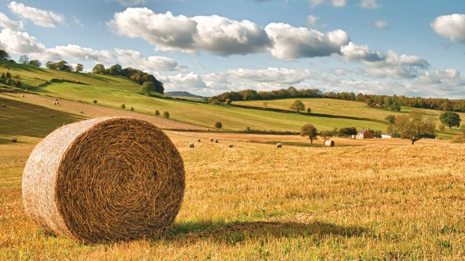
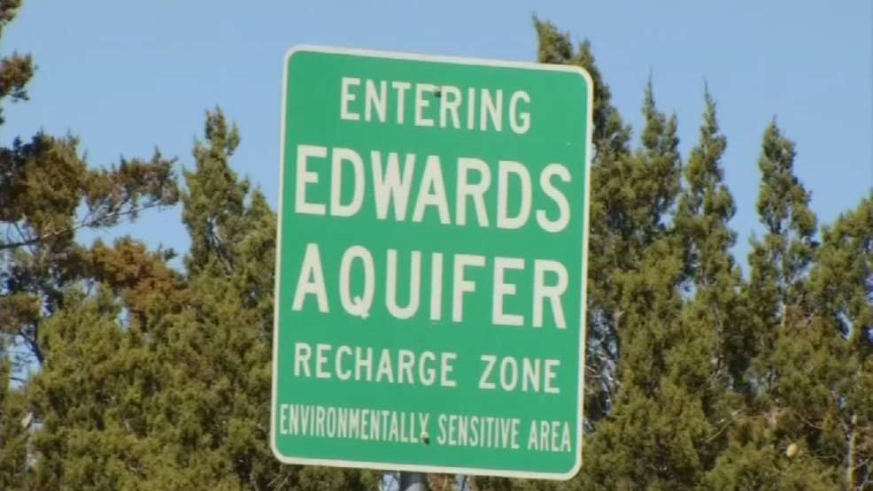
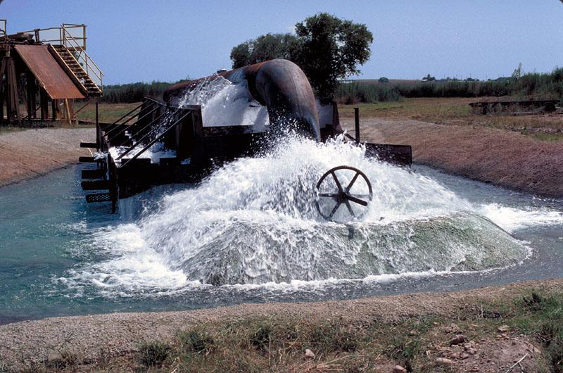
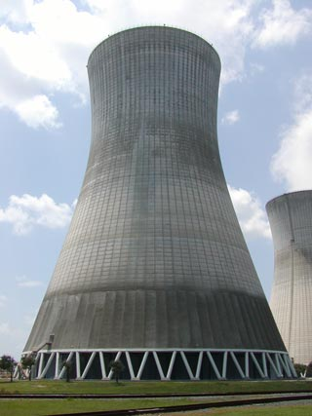



Climate Change, Bioenergy and Population Growth as they Stress the Food-Energy-Water Nexus
B.A. McCarl, ChengCheng Fei, Yingqian Yang
Department of Agricultural Economics
Texas A&M University
Presented Shanghai Jiao Tong University
May 2018

Slide 2
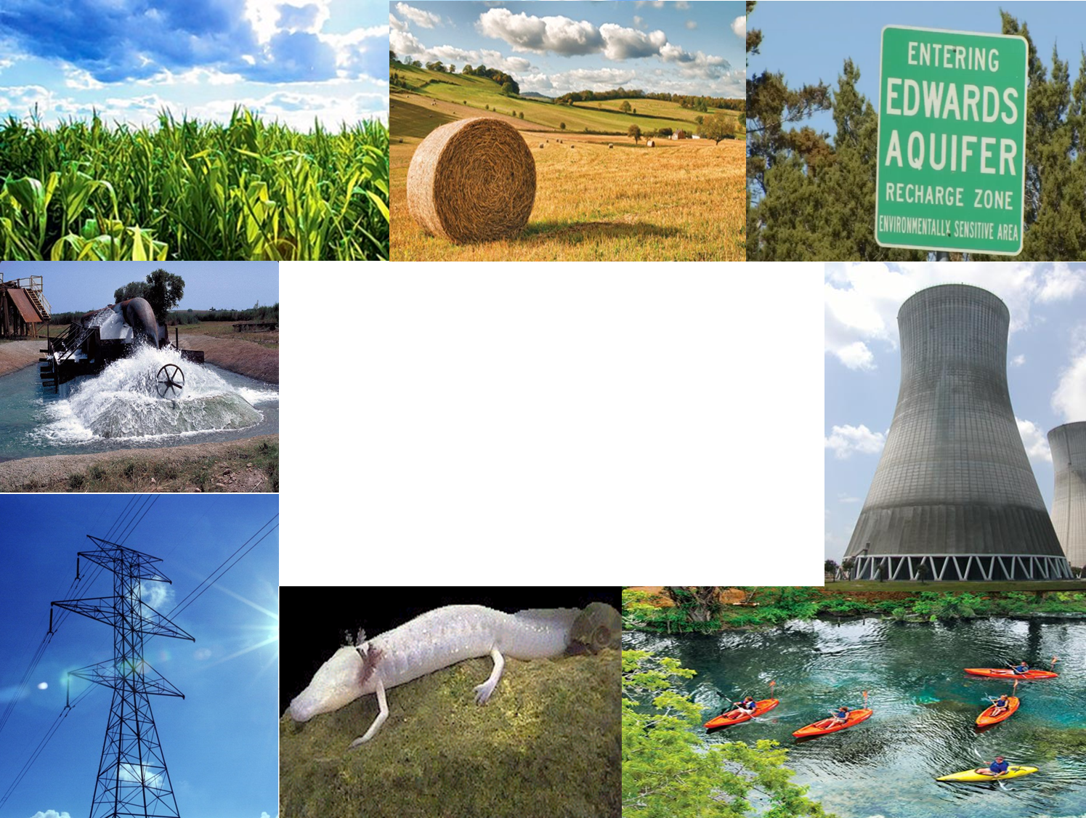
FEW Nexus
Food-Energy-Water Nexus Analysis considers way sectors interact in the food, energy and water space and in cases ways in which actions by some parties in the FEW sectors can benefit total regional welfare.
We are involved in Nexus Analysis in 2 settings
  Nexus analysis under Water scarcity: Limited supply and increasing demand for water are driving Nexus forces
  Nexus Analysis under major bioenergy decisions – US renewable fuel standard and whether we will expand cellulosic ethanol production plus use marginal land
Today I will mainly talk from the first project as that is one I am leading
This material is based upon work supported by the National Science Foundation under Grants addressing Innovations at the Nexus of Food, Energy, and Water Systems numbered 1639327 and 1739977

Slide 3
FEW Nexus – Water Scarcity
Water Scarcity FEW Nexus Analysis is stressed by evolving climate and population
  Climate
    Increases water demand in form of desired water use per acre, per household, for electrical cooling and for some other industries
    In study area lowers water supplies and increases variability
    In area lowers yields per unit land, lessening food supply
  Population growth
    Increases household and supporting industry water demand.
    Also increases demands for energy and food
Collectively makes Water scarcity worse
  Lowering supply and increasing demand for water plus adding energy and food demands while lowering food supply

Slide 4
FEW Nexus – Water Scarcity
In our study we examine FEW Nexus actions in the form of new water related sectoral investments and altered operating strategies- we collectively call these projects
We are working on defining projects:
  Agriculture related projects
  Water related projects
  Energy related projects
We also examine who gains and who loses as we feel Compensation and mechanisms to achieve it will be a big issue

Slide 5
Background on Regional Issues

Slide 6

Study Region - Geographic & Hydrologic Scope

Slide 7
Study Region - Geographic & Hydrologic Scope
Water Sources
4 River Basins
5 Aquifers
2 Springs
5 Lakes/Reservoirs
Users
Agriculture
Municipality
Industry
Energy - power plants and fracking)
Recreational
Environmental

Slide 8
Limited water supply : Rivers
Average precipitation in the region varies from 20 -30 inches (50-75 cm) per year in the ag areas in west to about 40 inches (100 cm) per year in the east
Sufficient flows needed for downstream water use and flows to Estuary to protect fishery and species.
Interaction with ground water
  Springs from Edwards Aquifer provide 30-80% of base flow in eastern river under drought
  Overpumping of groundwater will lower river flows

Slide 9
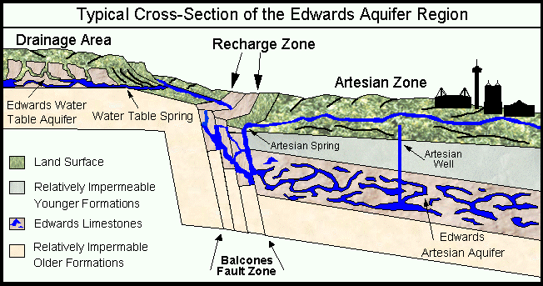
Limited water supply : Aquifers
Edwards Aquifer
Source: Edwards Aquifer Website http://www.edwardsaquifer.net/intro.html

Slide 10
Limited water supply : Edwards Aquifer
Problems
  Limited water supply (recharge)
  Heavy discharge (pumping and
  springs)
  Environment concerns and
  endangered species finding
EAA solution
  Edwards Aquifer Authority (EAA) issued permits to limit pumping and regulated withdraw amount based on water level
  Permit trading is allowed in EAA (water market)

Slide 11
Stochastic water supply Edwards Aquifer
Unit is thousands of acft which is 1,233 cubic meters)

Slide 12
Stochastic water supply : Aquifers
Edwards Aquifer does not retain water

Slide 13

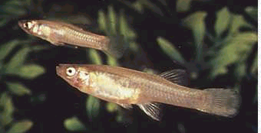
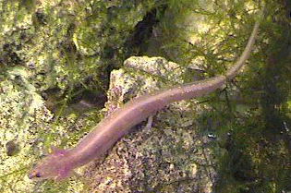
Environmental Issue - Edwards
Aquifer supports Endangered species
Texas Blind Salamander
Fountain Darter
San Marcos Gambusia
San Marcos Salamander

Slide 14
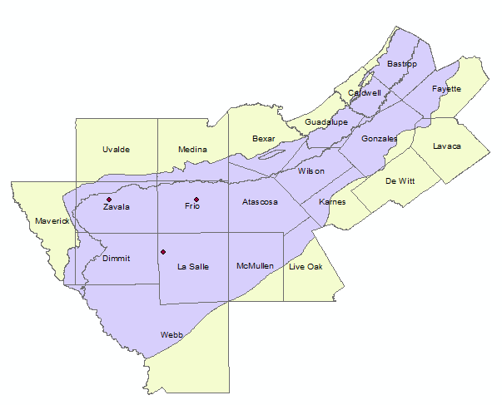
Carrizo-Wilcox Aquifer Water Level falling
In Groundwater Management area 13 covering southern segment of Carrizo-Wilcox Aquifer, desired 2070 condition is no more than 48 feet average drawdown relative to 2012

Slide 15
Background on Demand and Population

Slide 16
Regional Water Usage by Sector - 2015
Heavy water usage by municipal sector
Irrigation uses mainly groundwater

Slide 17
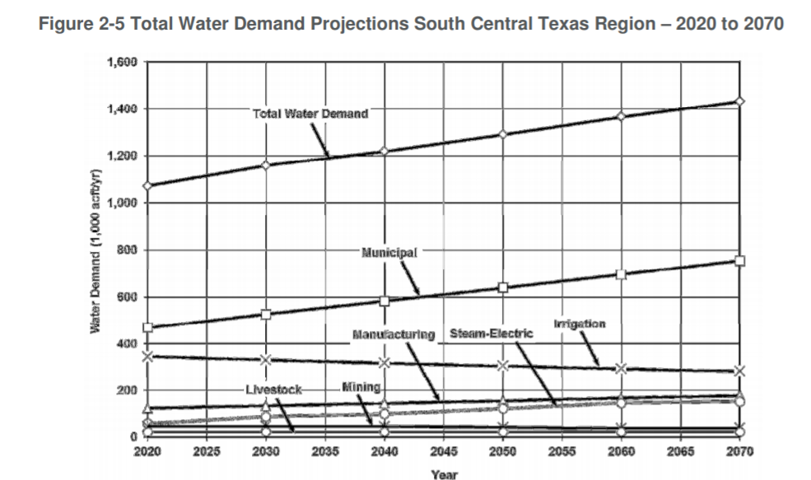
Rapid Population Growth
Population growth leads to
Rapid municipal industrial and electricity cooling demand
Growing deficit

Slide 18
Challenges from Fracking
Between 2000 and 2014, water used to drill a horizontal natural gas well increased from 177,000 to 5.1 million gallons per well
Fracking (mining) is largest water use in some counties.
Heavy fracking in winter garden increased Carrizo-Wilcox drawdown.

Slide 19
Climate Change

Slide 20
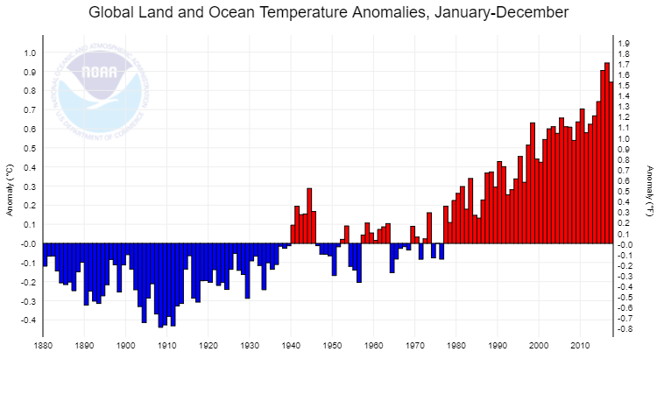
Temperature history
Year | Change from 20th Century Average | Rank out of 138 years
2014 | 0.74°C | 135
2015 | 0.90°C | 137
2016 | 0.94°C | 138
2017 | 0.84°C | 136
2017 was the third warmest year in NOAA's 138-year series.
41^{ht} consecutive year (since 1977) that annual temperature is above 20th century average.
All 17 years of 21st century rank are among seventeen warmest on record (1998 is ninth)
Six warmest years have all occurred since 2010
Four warmest have been last 4
Temperatures in 2015-2016 were majorly influenced by strong El Niño
Increased 0.07°C (0.13°F) per decade since 1880 and 0.17°C (0.31°F) since 1970

Slide 21
Climate Change is making things non stationary
http://www.edwardsaquifer.net/data.html

Slide 22
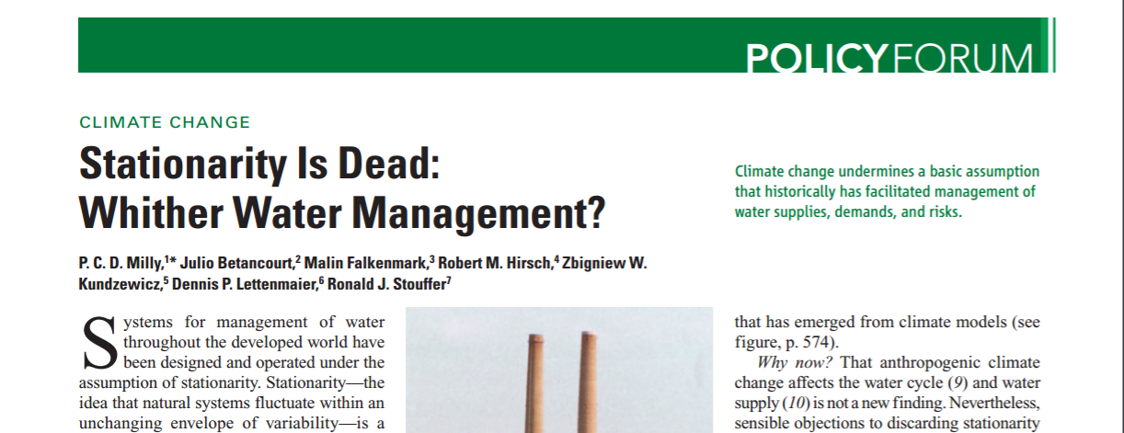
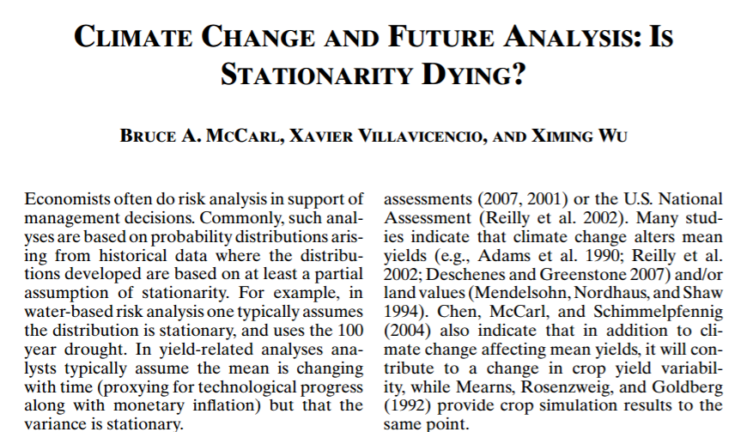
Climate Change is making things non stationary
Water
Can we use 100 year flood?
Milly, PCD, J. Betancourt, M. Falkenmark, 2008. Climate Change: Stationarity Is Dead: Whither Water Management?, Science, Vol. 319. No. 5863, pp. 573 – 574.
Ag yields
Can we history to assess risk?
McCarl, Bruce A., Xavier Villavicencio, and Ximing Wu. "Climate change and future analysis: is stationarity dying?." American Journal of Agricultural Economics 90.5 (2008): 1241-1247.

Slide 23
  Climate Change is making things non stationary
  USGS 05054000 RED RIVER OF THE NORTH AT FARGO, ND
Where is the dark Blue?
Note it is more common recently
https://www.ndsu.edu/fargoflood/images/red_river_of_the_north_raster_plot_august_2014.pdf

Slide 24
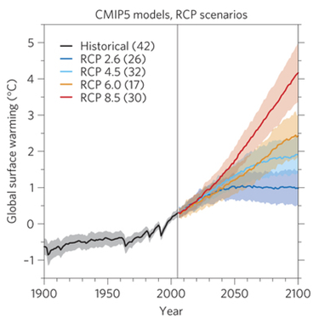
Yet more could happen
What could happen
What we have seen so far
Figure 1: Global temperature change and uncertainty. From Robustness and uncertainties in the new CMIP5 climate model projections
Reto Knutti & Jan Sedláček, Nature Climate Change 3, 369–373 (2013) doi:10.1038/nclimate1716,

Slide 25
Climate Change
    Use data for 2030 and 2090
        Canadian Climate Center Model (CCC)
        Hadley Climate Center Model (HAD)
        Average changes for the 10 year periods
Less water in much of Southwest region
(IPCC, WH2 AR5 chapter 3)
Climate Change Scenarios | Temperature (⁰F) | Precipitation (Inches)
HAD 2030 | 3.2 | -4.1
HAD 2090 | 9.01 | -0.78
CCC 2030 | 5.41 | -14.36
CCC 2090 | 14.61 | -4.56

Slide 26
Projections – Edwards Aquifer
Results for EA Recharge Prediction
(% change from the BASE )
Hadley
Canadian
Recharge in Drought Years
-20.59
-
-
29.65
Recharge in Normal Years
-
19.68
-
-
28.99
-
Recharge in Wet Years
-
23.64
-
-
34.42
-
    Municipal Demand
    Forecasted that climate change will increase municipal water demand by 1.5% (HAD) to 3.5% (CCC).

Slide 27
Climate Change
Edwards Aquifer is vulnerable under climate change, much less recharge under La Nina
Decreasing precipitation in far future makes Groundwater more vulnerable
Edwards Aquifer Recharge

Slide 28
Modeling

Slide 29
EDSIMR – the concept
Unify
  Detailed aquifer hydrologic model
  Regionalized economic Model
  Surface water flow model
  Hydrology embedded in regional economic model via regression (Keith Keplinger dissertation)
Keith O. Keplinger. "An investigation of Dry Year Options for the Edwards Aquifer. " Ph.D. Thesis, TAMU, 1996.
File Number 598 - Keplinger, K.O., and B.A. McCarl, "Regression Based Investigation of Pumping Limits and Springflow Within the Edwards Aquifer", Texas A and M University, 1995.
File Number 829 - Gillig, D., B.A. McCarl, and F.O. Boadu, "An Economic, Hydrologic, and Environmental Assessment of Water Management Alternative Plans for the South-Central Texas Region", Journal of Agricultural and Applied Economics, 33, 1 (April ), 59-78, 2001.

Slide 30
EDSIMR “System”
(and friends/ancestors)
Simulator Bundle
Crop and
Env
Simulators
(EPIC/SWAT)
Livestock
Data
Pest
Regressions
Non Ag
Resource
Demand
Regional
Crop Mix
input use
Env.
loads
EDSIMR
SWAT
Runoff
Simulators
(SWAT)
GIS
Water
Quality
GCMs
Groundwater
Simulator
(GAM)

Slide 31
EDSIMR – Components
Edwards Aquifer Groundwater and River System Simulation Model
What is contained in EDSIMR ?
Simulation Model (GAM)
Springflow, beginning/ending aquifer elevations, pumping
Econometric Model
Springflow/ending = f (beginning, recharge, pumping)
Mathematical Linear Programming
  Components : objective function
  : ag, M&I power and fracking decision variable
  : constraints
  : Surface water Network flow
  : ground water characteristics
  Linkage : Ground Water + Surface Water

Slide 32
EDSIMR – the scope
Water Rights, & Markets
Reuse
Aquifers
(Edwards, Carrizo-Wilcox, Gulf Coast, Trinity)
Water Project Use (Exist and New)
Treatment Plants
Investments
State of Nature
New Water Projects (Y/N)
Modeled Water Demand
Rivers (Nueces, Guadalupe, San Antonio)
Aquifer Diverters
River Diverters
Hydrological Processes
Energy Retrofits
(Y/N)
Reservoirs (Canyon , ChokeCanyon, ColetoCreek, Lake Corpus Christi, Medina Lake, Lake Texana)
Aquifer recharge, Depletion, Elevation
River Flows
Return Flows
Evaporation

Slide 33
EDSIMR – Demand Scope
Modeled Water Demand
Municipal Water
Water Projects (Exist & New)
Brackish Water
Reuse
Industrial Water Use
Electrical Cooling Water
Treatment Plants
Treatment Plants
Cropland
Crop Production
Aquifer Diversion
Agricultural Water Use
River Diversion
Fresh water
Pasture&
Range
Livestock Production
Fracking Water Use
Return Flows
Water Recreation
Red means we are
Working on adding it
Hydro-Electric
Environmental

Slide 34
EDSIMR – Objective function terms
Max Expected Regional Net Benefit
  Agricultural sector => revenues – production cost
  Non-agricultural sector => areas under demand – supply curves
  Power – operations cost and rev from fixed price
  Fracking – operations cost and fixed demand
  Env sector – to be determined
  Project cost and retrofit cost (water, power, fracking)

Slide 35
EDSIMR – Agriculture Sector
Land Modeling
Land Balance:
  Cropland + Pasture <= Total available land
Land Transfer
Land use decisions are made in Stage 1 of the model (CROPACRES and LIVEPROD)
Irrigate via Furrow
Dryland
Pasture
Irrigate via Sprinkler

Slide 36



EDSIMR – River flow detail
Upstream inflow
+ New Additional inflow
+ Return flow
+ Spring discharge
+ Lake release
+ Treated reuse
+ Project water
Diversion
+ Aquifer recharge
+ Evaporation
+ Lake addition
+ Downstream/bay outflow
=
R1
New additional
inflow
Evaporation
Aquifer
Recharge
R2
Add to Lake
Inflow
Spring
Discharge
Pump ground
c
Lake release
Diversion
User
Reuse
Return flow
Project water
Outflow
R3

Slide 37
Stochastic Model
Aquifer Storage and River Flow Identity
HDry
State of nature specific
Ag & M/I use
Water trades
Water projects flow
Spring flow
Aquifer elevation
Aquifer Storage
MDry
Energy and water projects & retrofits, crop mix, herd size, irrigation to dry, dry to pasture
Different
Precipitation
& Recharge
under
Different
SONs
Dry
DNormal
Normal
WNormal
Wet
MWet
HWet

Slide 38
EDSIMR Objective
Expected Net
Benefits
Maximization
Net Ag income from
Irr and dry Crop and
animalproduction
areas
under M&I
demand
curves
  The objective function is a probabilistically weighted
  across the states of nature to reflect stochastic weather
  Less SON independent costs
Ag
pumping
delivery costs
M&I
Water Mkt Transaction costs
Annual project dev costs - Integer
Crop plant cost
Animal acquisition annual cost
Cost of irr to dry or dry to past

Slide 39

EDSIMR – Agriculture Sector
Crop Mix Modeling
Crop Mix Balance
  Crop mix should be a convex combination of historical crop land allocation
  Dryland and Irrigated crops mixes are counted separately
  $$\sum_{zones}{CROPACRE_{county,zones,crops,irrigstatus}}≤\sum_{mixesa}{[CROPMIX_{county, irrigstatus,mixesa}}∗cropmixdata_{county, crops,irrigstatus,mixesa}]$$
  $$∀county,crops, irrigstatus$$

Slide 40
EDSIMR –Water rights, and Markets
Diversion Constraint:
  Amount of water diverted from river by one permit
  +Sold to others
  -Buy from others
  <= Permitted Capacity

Slide 41
EDSIMR – Projects
Water, Power, Fracking
Integer variables in most cases
Capacity Constraint
  Water from projects <= the project capacity if the project is built.
  0, otherwise
Project capacity may be stochastic
Operating cost per acre foot
Fixed amortzed construction costs per project
State of nature (stage 2) operation
Injection Balance
  Water could only be recovered in the Hdry state
  Water recovered in the Injection projects in Hdry state <= water injected into aquifer in other state of nature

Slide 42
EDSIMR – Basics of Stochastics
Stochastics
    Temp and precipitation
    Crop Yields and Water Requirements and pest costs
    Livestock stocking rate
    Livestock performance
    M&I demand
    Cooling requirements
    Water available

Slide 43
EDSIMR – Incorporating Water Markets
Water
Market
Water use and
rights
Agricultural
Water use and
rights
Municipal
Water use and
rights
Industrial
Includes friction in mkt ($50 in Edwards)

Slide 44
EDSIMR – Basics of Stochastics
Discrete Stochastic Model :9 weather states
2 Stage Decision
Stage 1
    Water and energy projects
    Crop mix
    Livestock numbers
    Initial levels of aquifers and reservoirs
Stage 2
    Crop water use strategy
    Recharge and surface inflows
    Pumping/diversion
    Water flows

Slide 45
EDSIMR – Conceptual Results
Projects built
Water Use Pattern and Trading
Economic Effect by party
    regional ag farm income + non-ag net surplus
    regional water prices and costs
Hydrologic Effect
    EA elevation at the J-17 well index and river flows
Environmental Effect
    spring flows, river flows, and the Estuary bay flows
Social Effect

Slide 46
Projects

Slide 47
WEF Alternatives – a starting point
Irrigation methods and practices Alternative crops
Ag Land to dryland or grazing Removing minimum limits
Degraded water use Crop mix
Dry year option
Water Use of more distant aquifers Injection &recovery
Reservoirs Saline sources
Enhanced recharge Conservation
Reuse Broader markets and leasing
Interbasin transfer
Energy Alternative cooling Coal to Natural Gas
Renewable sources wind solar Import more
Fracking water reuse Fracking technology

Slide 48
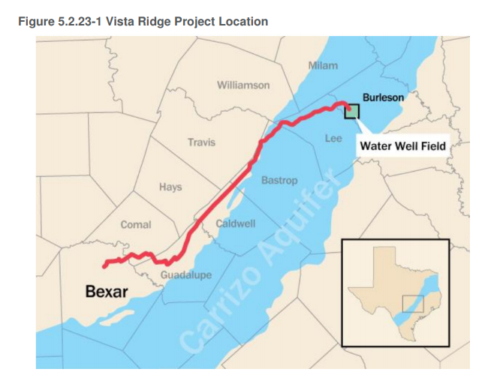
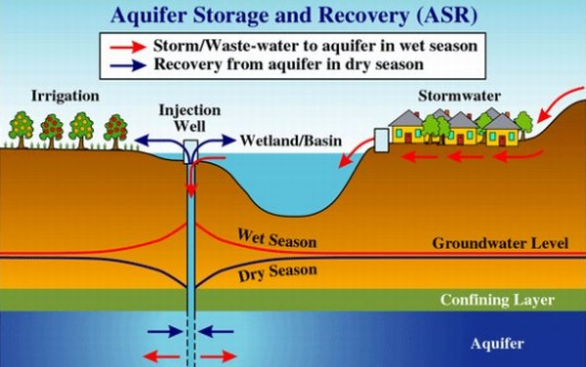
Water Projects Examples
  Out-of-Region Water Project: Vista Ridge
  143 miles pipelines
  Yield: 50,000 acft/yr
  Water cost full operation $1,976 /acft
  Total cost of facility: $493 million
  Pumping Energy: 156,691 MWh/year
  ASR Project: Luiling ASR
  Total cost of facility: $23 million
  Annual cost of water: $1,086 / acft
  Energy Consumption for pumping: 1,617 MWh/year

Slide 49
Power Plant Retrofit
Boiler retrofit (coal to natural gas)
Cooling retrofit
  (Once-through to Recirculating to Dry-cooling)
Switch to renewable source: Wind, solar and Nuclear.
Add new capacity in or outside region
  Could export water use
  Wind and solar reliability are issue
Retrofit and new capacity cost will be in first stage of the model

Slide 50
Public Goods Concern
Some Nexus actions will not be adopted by private individuals as they benefit the public not just the individual. In such cases the public may need to get directly involved in adoption.
Water Projects in our projects are public goods

Slide 51
Compensation Reallocation
When an entity like a Power plant could retrofit to save water but don’t do it because of cost
We need provide subsidy or compensation to the power plants to increase their incentive of cooling and heating retrofit.

Slide 52
Preliminary Result

Slide 53
EDSIMR – Example Analysis Objectives
Evaluate the economic and environmental consequences of a set of water management and energy project plans
Determine the “best” mix of water and energy retrofit options for a given demand and environmental constraints
Undertake a comparative assessment of the model “best” set of water management and energy project plans.

Slide 54
Base run -Agriculture Land
Land transfers from irrigated land to dry land and sprinkler irrigation is preferred to save water even with higher cost.
Few crop lands transfers to pasture

Slide 55
Agriculture Production Index
Vegetable production is very sensitive to precipitation. It is preferred during wet years (2020s, 2030s) but spurned in the dry years (2050s, 2060s).
Production index of all ag products also varies with precipitation.

Slide 56
Water Source by Sector
Demand increases over time with the growing population.
Municipal water needs driving expensive water projects proposed by Texas Water Development Board, or being implemented.
Municipal sector owns less surface water permits than agriculture and industrial sector in the region. Plus has means of financing.
Industrial water relies more on surface water over time, due to the shortage of water projects and groundwater drawdown

Slide 57
Water Source by Sector
Agriculture use less water under climate change, because the increasing demand of groundwater draw down the aquifer and make the water too expensive for agriculture usage.
Mining relies on ground water due to the shortage of surface water permits

Slide 58
Average Water Cost by Sector

Slide 59
Water Projects Selection
 | Available Projects | 2015 | 2020 | 2030 | 2040 | 2050 | 2060 | 2070
Surface Water Projects | 4
Ground Water Projects | 34 | 0 | 4 | 5 | 5 | 5 | 5 | 6
Aquifer Storage and Recovery | 7 | 0 | 2 | 2 | 2 | 2 | 2 | 2
Off-Channel Reservoir | 5
Outside Water Projects | 7
Fixed cost(Million $) |  |  | 3.87 | 3.89 | 0.02 |  |  | 17.60
Variable cost(Million $) | 0 | 0.00 | 29.18 | 35.28 | 35.17 | 35.12 | 40.82 | 72.69
Energy Consumption(MWh) |  |  | 3152 | 4274 | 4267 | 4263 | 5835 | 20220

Slide 60
EDSIMR – Sample Analysis Results
There is a distinct tradeoff in the EA region between the economic well being of pumping users and regional environmental attributes.
Leaving behind the rule of capture to take on the highest of the HCP motivated pumping limits reduces regional pumping user related welfare by $246 million per year. The most extreme limit examined (175,000 acft) under the emerging HCP raises the welfare loss to $633 million per year.
The emergence of the EA water market improves regional welfare to pumping users but worsens environmental attributes unless the East-West pools could somehow be factored into its design.
Water development from alternative sources will be stimulated greatly by HCP related EA use restrictions.
The EA region will have to develop an expanded set of water development alternatives if the severe Habitat Conservation Plan based restrictions are imposed.

Slide 61
EDSIMR – Sample Analysis Results
  The EA ag sector is worse off.
  The economic gain accrues to the EA non-agricultural sector, but is basically offset by the water development costs.
Gillig, D., B.A. McCarl, and F.O. Boadu, "An Economic, Hydrologic, and Environmental Assessment of Water Management Alternative Plans for the South-Central Texas Region", Journal of Agricultural and Applied Economics, 33, 1 (April), 59-78, 2001.

Slide 62
EDSIMR – Sample Analysis Results

Slide 63
Conclusion
Agriculture transfer land from furrow irrigation to sprinkler irrigation to dryland to save fresh water and avoid high pumping cost
Building more water projects could destress water scarcity and increase social welfare.
More water projects are built over time. ASR and Groundwater projects are preferred due to extra water source and lower fixed and operating cost

Slide 64
Future Research
Enhance the preliminary electrical energy part improving data and modeling on cooling alternatives and the use of electricity when developing the water projects
Add Edwards Aquifer Authority water management strategies/regulation and water marketing into the model.
Add alternative strategies via which fracking can reduce its usage of fresh water
Develop information on how water supply, crop yield and irrigated crop water use are affected by climate change scenarios in interaction with the SWAT, hydrological modeling group.

Slide 65
Preliminary Result

